Slide 1
Neural Nets with Pytorch
Session 3: Convolutional Neural Nets

Slide 2
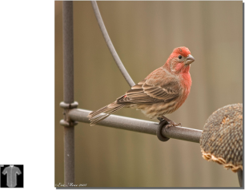
Image Classification
A 28x28x1 image is only 784 neurons.
But what if the image is larger? And in color?
224x224x3=150528

Slide 3
Image Classification
Solution: Convolutional Neural Networks
Advantages over MLPs:
1. Weight Sharing
2. Sparse connections
Hence: reduced parameter count.

Slide 4
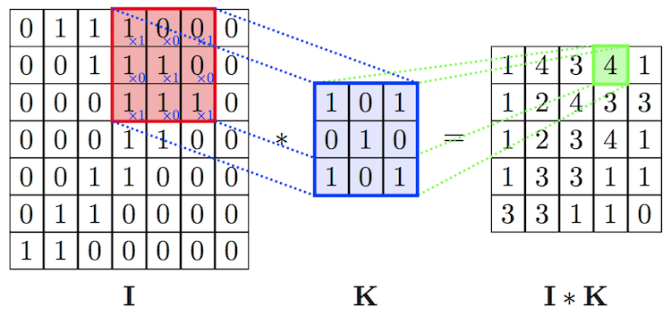
Neural Convolution

Slide 5
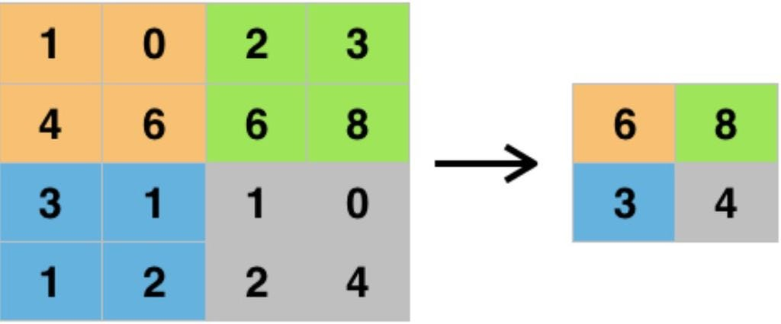
Downsampling
Max Pooling

Slide 6
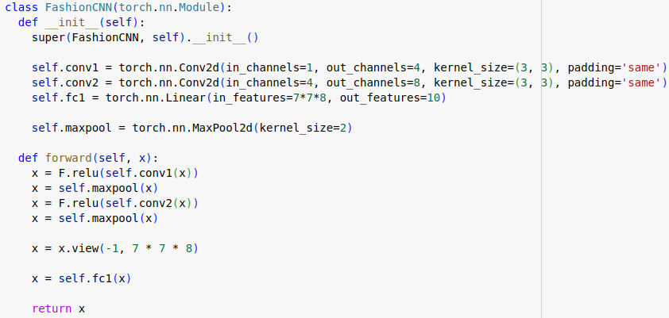
Pytorch Example
Need to calculate input neurons in FC layer

Slide 7
Practical Considerations
GPUs
Learning Rate

